Slide 1
“LIGHT DETECTOR USING NAND GATE ” BY
Mini-Project-I
PRESENTATION ON
Student Name : USN:
Navya.M.K - 1NH18EC075
Meghanashree.C - 1NH18EE029
Nivedita Salimath - 1NH18EC080
Sowmya.L - 1NH18EC108
GUIDED BY: Ms.NAYANA
Senior assistant professor
Dept. of ECE
New Horizon College Of Engineering

Slide 2
INDEX
Introduction
Literature review
Aim and Objectives of Project
Circuit Diagram
Design
Project Description
Progress Work
Milestone
Outcome of project
References

Slide 3
INTRODUCTION
A Light detector or light sensor is a device or circuit that detect the light intensity on it. Different types of light detectors are LDRs(light dependent resistors),photo diodes, photo transistors etc.
All these devices are called as photoelectric devices as they convert light energy to electric energy. These light detectors or sensors can detect different types of light like visible light, ultraviolent light, infrared light.
In this project we have designed a simple light detector using LDR.when light falls on LDR,the light stays on and when the light stops falling on LDR,the LED doesn’t glow.

Slide 4
LITERATURE REVIEW
Paper No | Title | Author & Year of Publication | Outcome
1. | Random susceptibility of an IC 7400 TTL NAND gate. | James Gormady; Donald Weiner; Published in 1983 | Pin diagram ,maximun and minimun current and voltage values for NAND gate.
2. | Develpoment of street lighting system with vechicular sensing at low light intensity based on Bigbee inteligence. | V.Shiva prasad nayak; A.Vinay krishna; Published in 2016. | Working of LDR.
3. | The study of velocity measurement using single light dependent resistor (LDR) Sensor . | Muhamad Zia Pratama Hernawan;Dian Ahmad Hapidin; Published in 2018. | Velocity range for LDR

Slide 5
AIM and OBJECTIVE
AIM:- To detect the light when the circuit is exposed to brightness.
Objective:-
Light detector using NAND gate.
Components:-
1. NAND gate IC 7400.
2. LDR.
3. LED.
4. Resistors 1kohm,6.8kohms.
5. Connecting wires.
6. Bread board.
7. Regulator.
8.Buzzer.

Slide 6
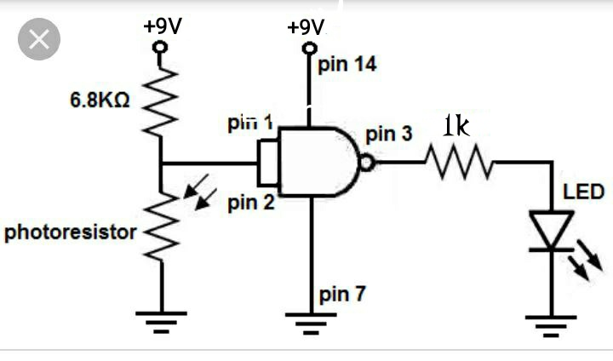
CIRCUIT DIAGRAM

Slide 7
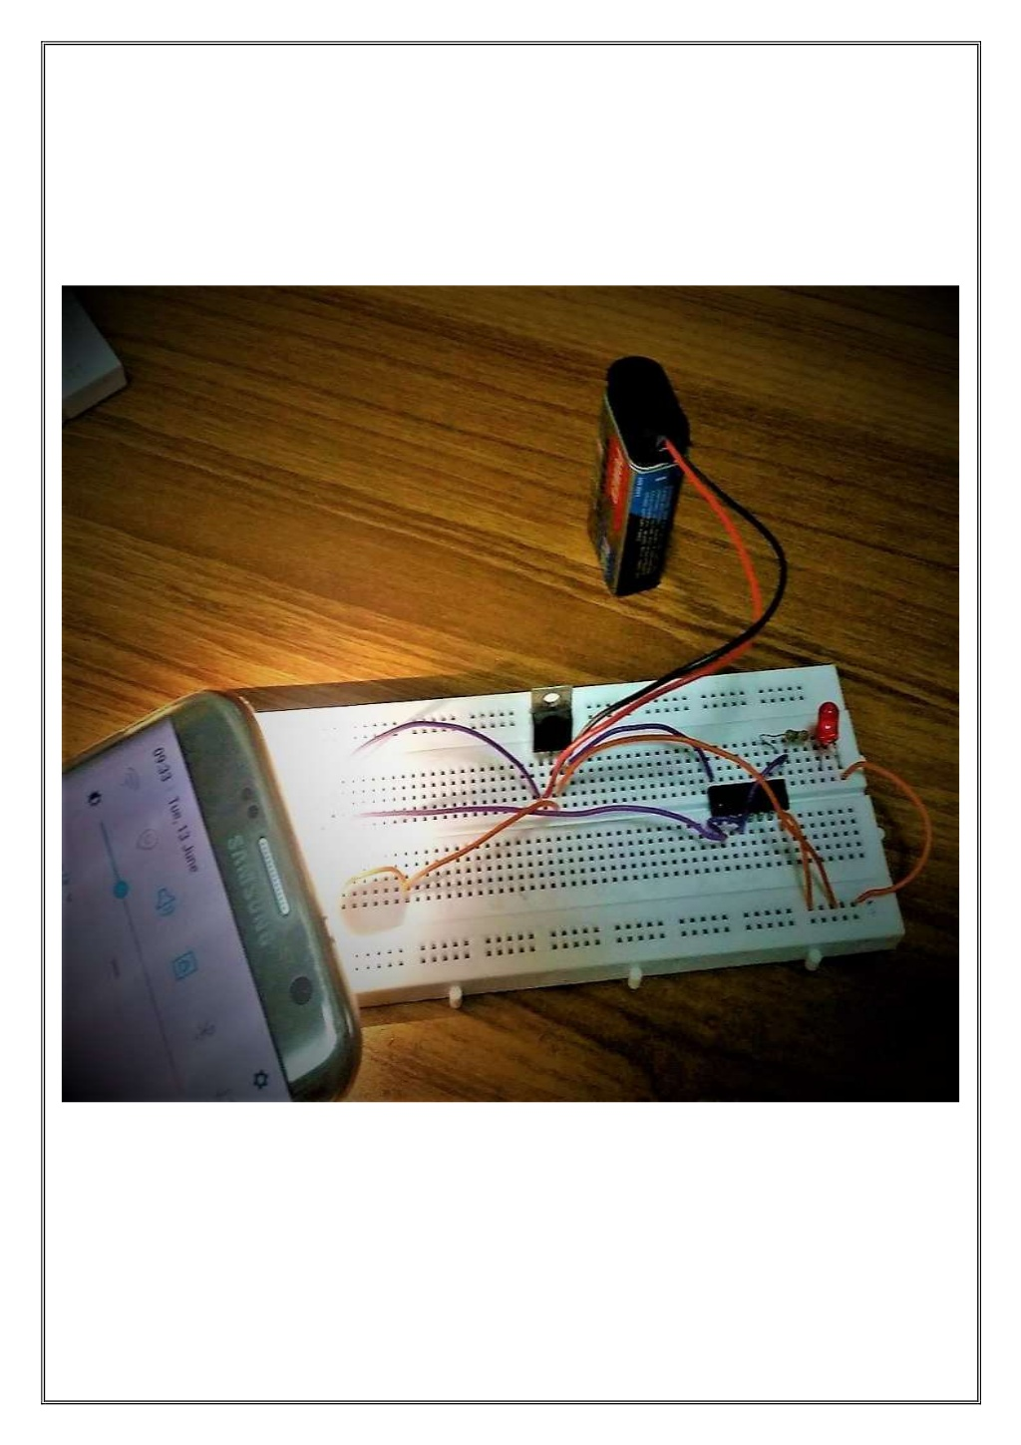

Slide 8
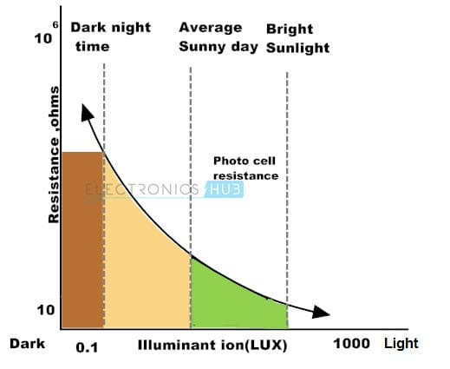
DESIGN FOR 6.8KOHM:
In darkness, set the logic high as 8v.
voltage across LDR=8V
V_{L} =VR_{L} /R₁+R₂
R₁ =VR_{L} /V_{L} -R_{L}
hence,RL will be in same meghaohms
In bright sunlight,set the logic low as 1v.
V_{L} =VR_{L} /R₁+R₂
R₁=VR_{L} /V_{L} -R_{L}
Hence,R_{L} will be reduced to same kiloohms taking average of R₁ we designed as 6.8kohm.

Slide 9
Taking digital values for NAND gate:
Case 1:
LDR will be in Darkness hence it’s resistance will be in Ms resistance will be in MΩ
Voltage across LDR, V_{L}=VR_{L}/R₁+R_{L} R₁=6.8KΩ
R_{L} =1.8MΩ
V_{L}=(9*1.8M)/(6.8K+1.8M)
V_{L}=8.96V
V_{L}=8.96V which is greater than 4.5V(threshold voltage) Since V_{L}>threshold voltage
.’. logic is set to high i.e; Logic 1.
Case 2:
LDR will be in Bright light hence it’s resistance will be in 1KΩ
V_{L}=VR_{L}/R₁+R_{L}
R_{L}=6KΩ
V_{L}= 4.21V
V_{L} = 4.21V which is less than 4.5V(threshold voltage)
.’. logic is set to low i.e; log 0.

Slide 10
Current range of LED is 12 to 20mA. To overcome that range, we need highresistance.
R=V/I
R=(9/20m)=450Ω
We need a resistance which is 450Ω or more than that i.e; we choose 1KΩ
I=V/R=9/1K
I=0.009
I=9mA
In order to protect our LED we choose 1kΩ.

Slide 11
PROJECT DESCRIPTION
WORKING:-
Firstly, we must give power to the NAND gate IC,we will feed it 9V of power. So we get +9V to pin 14 and we connect
pin 7 to GND. This establishes power to the IC.
The circuit is very basic.The component that allows us to detect light is a photoresistor(LDR).We set up a Voltage
divider circuit composed of a photo resistor and a 6.8kohm fixed resistor. In a voltage divider circuit voltage is
distrubuted across the components in direct proportion to the amount of resistance each component offers.
The more resistance a component offers in relation to the other,in relation to the other,the more voltage that will
fall across that component.This is shown in the ohm’s law formula V=IR.we can see the direct relationship between
voltage and resistance in the formula.The greater the resistance a component offers, the more voltage that falls across
it, conversly,the less resistance a component offers,the less voltage that falls across it.
When a photo resistor is exposed to darkness, it has very high resistance, in the order of few mega ohms(Mohms),
with resistance this high,most of the voltage from the power supply feeding the voltage divider circuit falls
across the photo resistor,with very little voltage falling across the 6.8Kohm fixed resisitor.

Slide 12
Thus,when connected to the inputs of NAND gate,with voltage so high, the NAND gate will essentially interpret the voltage divider as if it were HIGH(or 1).when the voltage feeding the inputs of a NAND gate are greater than half of the power supply voltage ,it will interpret it as a HIGH value.Since we will tie both input together, the NAND gate will interpret this as two ones, so it will output a 0 (OR LOW) which means the output will be drawn down to ground and the load will not be powered. Remember, NAND gate logic, two ones gives a zero. This is the only time will get a output value zero in NAND gate logic. If a zero is present anywhere in the inputs, including twice,the NAND gate will output a 1.
When a photoresistor is exposed to a bright light, its resistance drops dramatically, in order of 20-30kohms,or less, depending on the type in use. With this resistance this low, most of the voltage from the power supply falls across the 1kohm resistor, and less than half falling across the photoresistor.With voltage this low , the NAND gate will interpret as logic level of zero.Thus,the output will be drawn up to VCC and the load,led,will be powered on .
So you can see how this voltage divider circuit allows us to get 2 different logic level produced by the NAND gate IC in different lighting conditions.

Slide 13
PROGRESS
2nd September-Collecting information about the topic.
6th September-we bought the requried components for our project.
9th September - Analysing the circuit and it’s design part.
11th September-Partial completion of ppt and report.
12th September -Construction of circuit on breadboard.
14th September-First review.
25th September-Discussion about the difficulties in the construction part with groupmates.
4th october-Completed ppt and report.
15th october-Improvising ppt and report.
19th october-Completed the project along with ppt and report.

Slide 14
Milestones/Schedule
Table A - Milestones scheduled for achievement and performance against those milestones:
Milestone | Baseline Date | Target Date | Achievement
Mini project assigned. | 16\08\2019 | 25\08\2019 | The topic light detector were finalised.
Division of work and accqusition of components. | 30\08\2019 | 2\09\2019 | Components were purchased and working on project were started
PPT and report. | 9\09\2019 | 11\09\2019 | 50%completed
Finale PPT and report. | 16\09\2019 | 19\09\2019 | 100%completed

Slide 15
Project Work Distribution
Name of Team Member | Work distributed
Nivedita Salimath | Mounting the components,testing of the model.
Navya.M.K | PowerPoint presentation, Construction and working.
Meghanashree.C | Report, Construction and working.
Sowmya.L | Mounting the components,testing of the model.

Slide 16
OUTCOME OF PROJECT
OUTCOME:
When the LDR is exposed with the light the resistance of LDR decreases, as a result the led glows.
APPLICATIONS:
Simple light detector circuit can be used in many applications like automatic switching of appliances up on detecting light,security system,etc.
This system can be used in alarm system, where increasing intensity of light will trigger the alarm.
It can also be used in cupboards or wardrobes.When the door is opened, the light will automatically turned on.
16

Slide 17
REFERENCES :
1.https://youtu.be/MTIPO8uM128 - www.youtube.com
2.https://youtu.be/BXthKwFPxvc - www.youtube.com
3.https://youtu.be/-JrocsbN49o - www.youtube.com
4.https://www.learningaboutelectronics.com/Articles/Light-detector-circuit-with-NAND-gate.php
BOOKS:
Newnes Digital logic IC pocket book by R MARSTON.

Slide 18


